Slide 1

Silverlight 2D Graphics
Radoslav Kirilov
National Academy for Software Development
academy.devbg.org

Slide 2

Contents
Basic shapes
Paths and geometries
Text
Strokes and brushes
Images and transparency

Slide 3
Basic Shapes

Slide 4
Basic Shapes
Silverlight includes set of elements that represent shapes
  Rectangle and Ellipses
  Lines
  Polygons
  Path
Shape Properties
  Fill
  Stroke
  StrokeThickness

Slide 5
Lines
The Line represents a straight line that connects one point to another
The starting and ending points
  Set by four properties - X1 and Y1 (for the first point) and X2 and Y2 (for the second)
The coordinates you use in a line are relative to the top-left corner
<Line Stroke="Blue" X1="0" Y1="0" X2="10" Y2="100"
StrokeThickness="5"></Line>

Slide 6
Rectangle and Ellipse
The Rectangle and Ellipse are the two simplest shapes
Height and Width properties
  Define the size of shape
Fill or Stroke property
  Make the shape visible
Rectangle class adds two important properties
  RadiusX and RadiusY

Slide 7

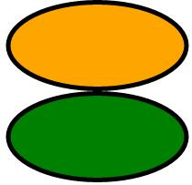
Example
<Rectangle Width="200" Height="150"
Stroke="Black" StrokeThickness="5" Fill="Orange"
RadiusX="10" RadiusY="10"/>
Rectangle and Ellipse – Find the difference ☺
<StackPanel>
<Rectangle Width="200" Height="100"
Stroke="Black" StrokeThickness="5" Fill="Orange"
RadiusX="100" RadiusY="70"/>
<Ellipse Width="200" Height="100"
Stroke="Black" StrokeThickness="5"
Fill="Green" />
</StackPanel>

Slide 8

Polygon
Allows us to draw a sequence of connected straight lines
Has a Points collection
  Takes a list of coordinates
Adds a final line segment
The FillRule property
<Polygon Stroke="Blue" StrokeThickness="1" Fill="Yellow"
FillRule="Nonzero"
Points="15,200 68,70 110,200 0,125 134,125">
</Polygon>

Slide 9
Path (2)
Used for complex design
Data property
  Contains information defining the path
A path consists of several painting instructions
Each instruction consists of:
  A capital letter denoting the command
  One or more parameters

Slide 10
Path
Instructions
  Moving the virtual "pen" to a certain position – M (M 40,30)
  (L 40,30)- line between the current position and the provided point
  H, V – Horizontal or Vertical line
  A – arc
    X and Y radius of an ellipse
    Rotation angle of the ellipse
    If larger than 180 degrees and direction
    Endpoint

Slide 11
Path
Instructions
  Q – Quadratic Bezier
    One control point and End Point
  C – Cubic Bezier
    Two control points and End Point

Slide 12
Path
Live Demo

Slide 13
Paths and Geometries

Slide 14
Line, Rectangle, and Ellipse Geometries
LineGeometry, RectangleGeometry, and EllipseGeometry classes
  Map directly to the Line, Rectangle, and Ellipse shapes
Differences
  Rectangle shape takes Height and Width values
  RectangleGeometry takes four numbers that describe the size and location of the rectangle

Slide 15
Line, Rectangle, and Ellipse Geometries (2)
Differences
  Line takes four properties – X1,X2,Y1,Y2
  LineGeometry takes two properties – StartPoint and EndPoint
  Ellipse takes Height and Width values
  EllipseGeometry takes RadiusX, RadiusY, Center

Slide 16
Line, Rectangle, and Ellipse Geometries
Live Demo

Slide 17
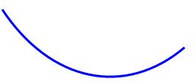
Arcs
Creates an elliptical arc between two points
ArcSegment property
  Identify the endpoint of the line
PathFigure element
  Draws a curved line
<Path Stroke="Blue" StrokeThickness="3">
<Path.Data>
<PathGeometry>
<PathFigure IsClosed="False" StartPoint="10,100" >
<ArcSegment Point="250,150" Size="200,300" />
</PathFigure>
</PathGeometry>
</Path.Data>
</Path>

Slide 18
Curves
Bézier Curves
  Connect two line segments
  Uses a complex mathematical formula
    Incorporates two control points that determine how the curve is shaped
Define a Bézier curve
  Three points
    The first two points are the control points
    The third point is the endpoint of the curve

Slide 19
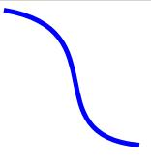
Example
<Path Stroke="Blue" StrokeThickness="5" Canvas.Top="20">
<Path.Data>
<PathGeometry>
<PathFigure StartPoint="10,10">
<BezierSegment Point1="130,30" Point2="40,140"
Point3="150,150">
</BezierSegment>
</PathFigure>
</PathGeometry> <!--The result is-->
</Path.Data>
</Path>

Slide 20
Curves
Live Demo

Slide 21
Text

Slide 22
TextBlock
Use a TextBlock element to add text to Silverlight user interface
Properties
  FontFamily
  FontSize
  FontStyle
  FontWeight
  FontStretch
  TextDecorations
  TextWrapping

Slide 23

TextBlock - Example
<TextBlock TextDecorations="underline" FontFamily="Arial" FontSize="25" Foreground="OrangeRed">Silverlight</TextBlock> <TextBlock Width="100" TextWrapping="Wrap"
Text="This text will not fit in one line." />

Slide 24
Rich Text
Content property of TextBlock is not text
  It is a collection of objects called Inlines
Objects can be added to the Inlines collection
  Run
  LineBreak
LineBreak adds a newline

Slide 25
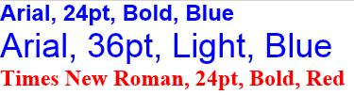
Rich Text (2)
Run element
  Provide inline formatting options
<TextBlock Foreground="Blue" FontFamily="Arial" FontSize="24" FontWeight="Bold">
Arial, 24pt, Bold, Blue
<LineBreak />
<Run FontSize="36" FontWeight="Light" Text="Arial, 36pt, Light, Blue" />
<LineBreak />
<Run FontFamily="Times New Roman" Foreground="red" Text="Times New Roman, 24pt, Bold, Red" />
</TextBlock>

Slide 26
Fonts
The basic font properties exposed by TextBlock are
  FontFamily
  FontSize
  FontStyle
  FontWeight
  FontStretch
Using custom fonts

Slide 27
Strokes and Brushes

Slide 28
Brushes
Concept of a Background and Foreground
  Background is the surface of the element
  Foreground is the text (as with the TextBlock)
Fill and Stroke properties
  Paint the interior region of the shape and the border around it
These properties use the Brush object

Slide 29
Brushes (2)
Brush classes
  SolidColorBrush
  LinearGradientBrush
  RadialGradientBrush
  ImageBrush
  VideoBrush
Give flexibility or something more exotic

Slide 30
Gradient Brushes
Offset property
  Places a color at a specific location in the gradient
  Can range from 0 to 1
<Rectangle Width="150" Height="100">
<Rectangle.Fill>
<LinearGradientBrush>
<GradientStop Color="Yellow" Offset="0.0" />
<GradientStop Color="Red" Offset="0.25" />
<GradientStop Color="Blue" Offset="0.75" />
<GradientStop Color="Green" Offset="1.0" />
</LinearGradientBrush>
</Rectangle.Fill>
</Rectangle>

Slide 31
Gradient Brushes
Live Demo

Slide 32
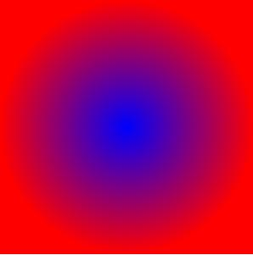
RadialGradientBrush
Has a single starting point
  With each GradientStop emanating from it in the shape of an ellipse
GradientOrigin property
SpreadMethod property
<Rectangle Width="300" Height="300">
<Rectangle.Fill>
<RadialGradientBrush>
<GradientStop Offset="0" Color="Blue"/>
<GradientStop Offset="1" Color="Red"/>
</RadialGradientBrush>
</Rectangle.Fill>
</Rectangle>

Slide 33
Using Brushes to Fill Text
Brushes aren’t limited to shape drawing
<TextBlock FontSize="25" FontFamily="Arial" TextWrapping="Wrap">
<TextBlock.Foreground>
<LinearGradientBrush>
<GradientStop Color="Yellow" Offset="0.0" />
<GradientStop Color="Red" Offset="0.25" />
<GradientStop Color="Blue" Offset="0.75" />
<GradientStop Color="Green" Offset="1.0" />
</LinearGradientBrush>
</TextBlock.Foreground>...

Slide 34
Brushes to Fill Text
Live Demo

Slide 35
Images and Transparency

Slide 36
Images
Silverlight is a vector-based technology
  But pixel images are supported too
Image element
Source property
  Provided the information which graphics image will show
Supported graphics formats - JPEG and PNG
<Image Source="Silverlight.jpg"></Image>

Slide 37
Transparency
Ways to make an element partly transparent
  Set the Opacity property
  Use a semitransparent color
  Set the OpacityMask property
    Accepts any brush
<Rectangle Fill="Blue" Width="300" Height="200">
<Rectangle.OpacityMask>
<LinearGradientBrush StartPoint="0,0" EndPoint="1,0"> <GradientStop Offset="0" Color="Black"></GradientStop>
<GradientStop Offset="1" Color="Transparent"> </GradientStop>
</LinearGradientBrush> …

Slide 38
Images and Transparency
Live Demo

Slide 39
Silverlight 2D Graphics
Questions?

Slide 40
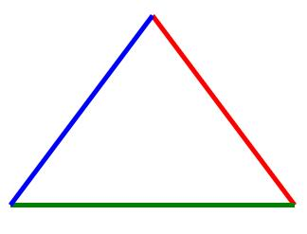

Exercises
Write a program that shows a triangle with three lines
Write a program that shows a star which is filled with red color and blue borders. The center region is not filled

Slide 41

Exercises (2)
Silverlight supports nine font families. Write a program that shows the all fonts (Use Google to find the name of the fonts)
Write a program that shows this text
Write a program that shows a vertical blue-to-red colored text

